Slide 1

Machine Learning to detect
Fake News
May 16, 2017
Presented By: Navkiran Kaur
CWID: 802974436
CPSC 597

Slide 2
Agenda
IMPLEMENTATION
Demonstration
Algorithm Comparisons
RESULTS/ANALYSIS
Challenges
References
MACHINE LEARNING
SUPERVISED LEARNING
TECHNOLOGIES USED
ALGORITHMS
NAVE BAYES
SUPPORT VECTOR MACHINE
LOGISTIC REGRESSION
K NEAREST NEIGHBORS
DATASET
DATA SET DESCRIPTION

Slide 3
Machine Learning
Machine Learning is a technique of a data science that helps computers learn from existing data in order to predict future outcomes
It explores the study and construction of algorithms that can learn from and make predictions on data
It has strong ties to mathematical optimization
It can be categorized as Supervised or Unsupervised learning

Slide 4
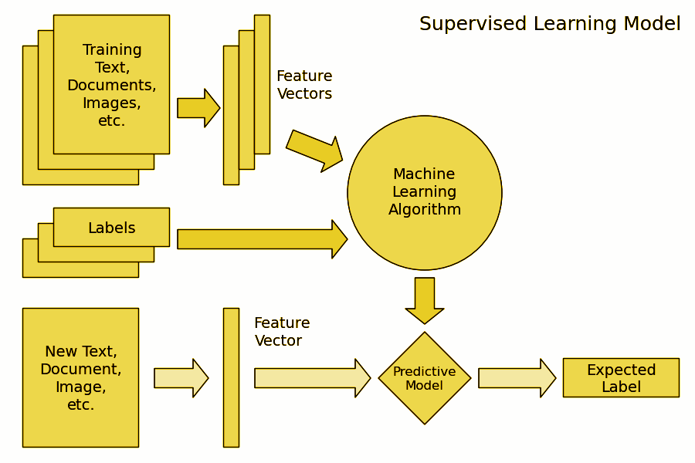
Supervised Learning

Slide 5
Technologies Used
Python
Python Library
Pandas
Scikit Learn
IPython - Jupyter( Notebook)
MatPlotLib
Natural Language Processing (NLP)
Machine Learning - Algorithms

Slide 6
AlgorithmS
Naive Bayes
One of supervised learning algorithm based on probabilistic classification technique.
It is a powerful and fast algorithm for predictive modelling.
In this project, I have used the Multinomial Naive Bayes Classifier.

Slide 7
Support Vector Machine- SVM
SVM’s are a set of supervised learning methods used for classification, and regression.
Effective in high dimensional spaces.
Uses a subset of training points in the support vector, so it is also memory efficient.

Slide 8
Logistic Regression
Linear model for classification rather than regression.
The expected values of the response variable are modeled based on combination of values taken by the predictors

Slide 9
K Nearest Neighbors
It a nonparametric method used for classification and regression.
The input consists of the k closest training examples in the feature space.
It can give highly competitive results even being the simplest algorithm.

Slide 10
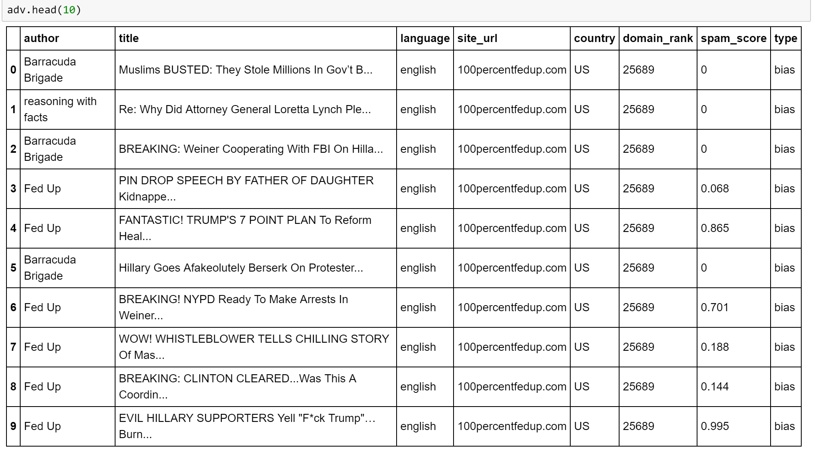
DataSet 1

Slide 11
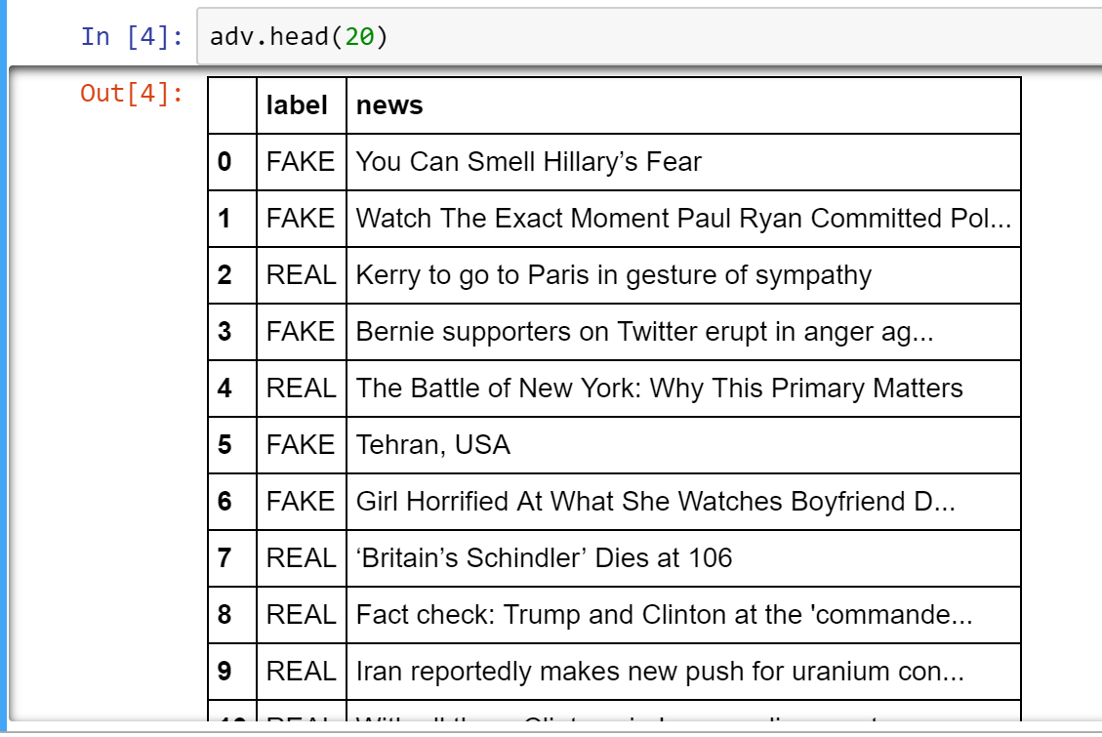
DataSet 2

Slide 12
DataSet Description
Dataset 1- https://www.kaggle.com/mrisdal/fake-news
Includes- author, title, language, site_url(from BS detector), country, domain_rank, spam_score, type
Dataset 2- https://UCI/REPOSITORY
Includes- the label and news

Slide 13
Implementation
Importing packages such as pandas, numpy, csv, and importing algorithms from sklearn as we are using the Python Library.
Reading the CSV file and displaying the data set.
Remove the erroneous null and nan values.
Calculating the length of news so as to check the length of fake and real news.
Data Preprocessing - NLTK tokenization
Tokenizing and normalizing the text
Lemmatization and Vectorization
Feature Extraction
Training a model to detect fake
Build and evaluate
Evaluate Accuracies

Slide 14
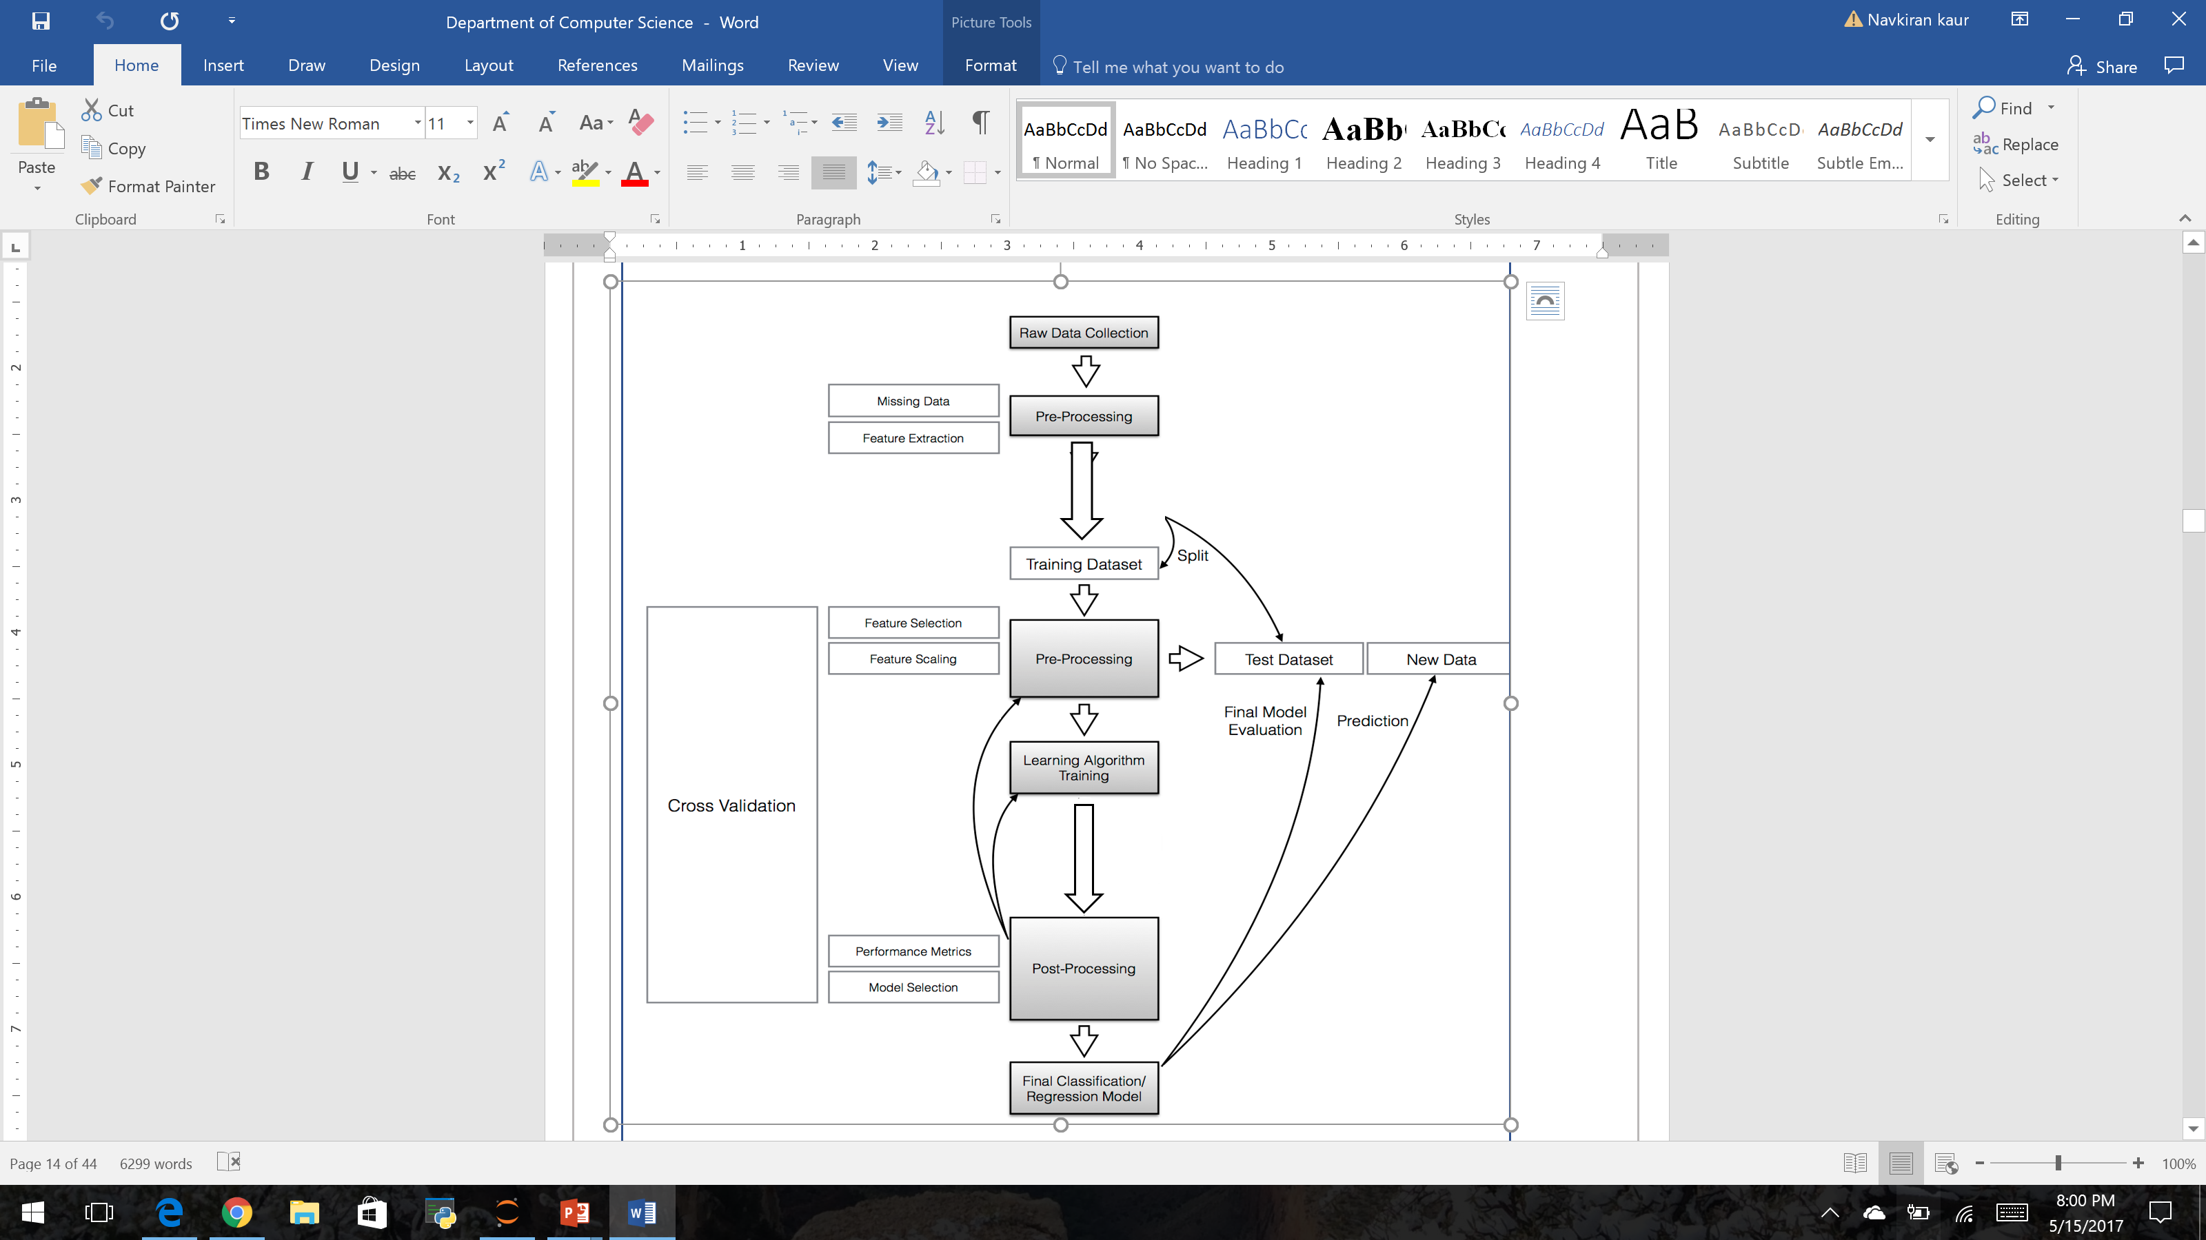

Slide 15
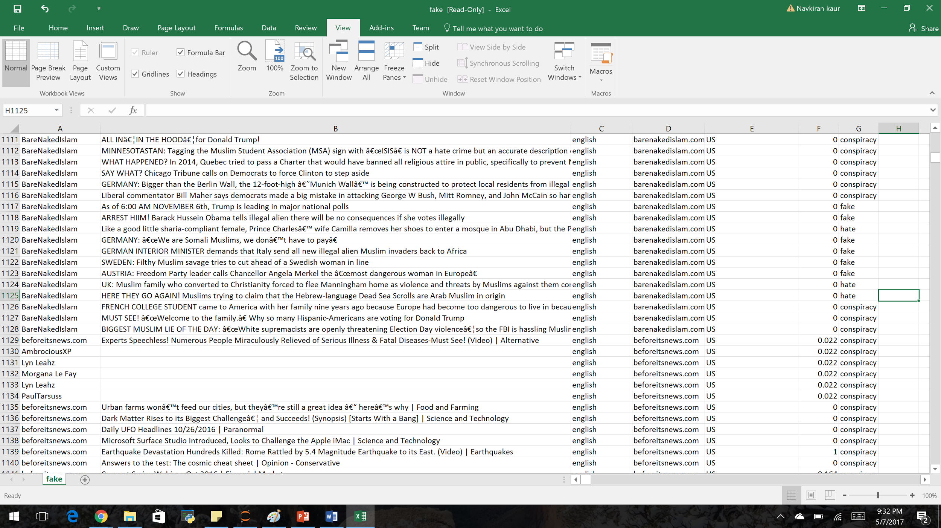
Raw Data

Slide 16
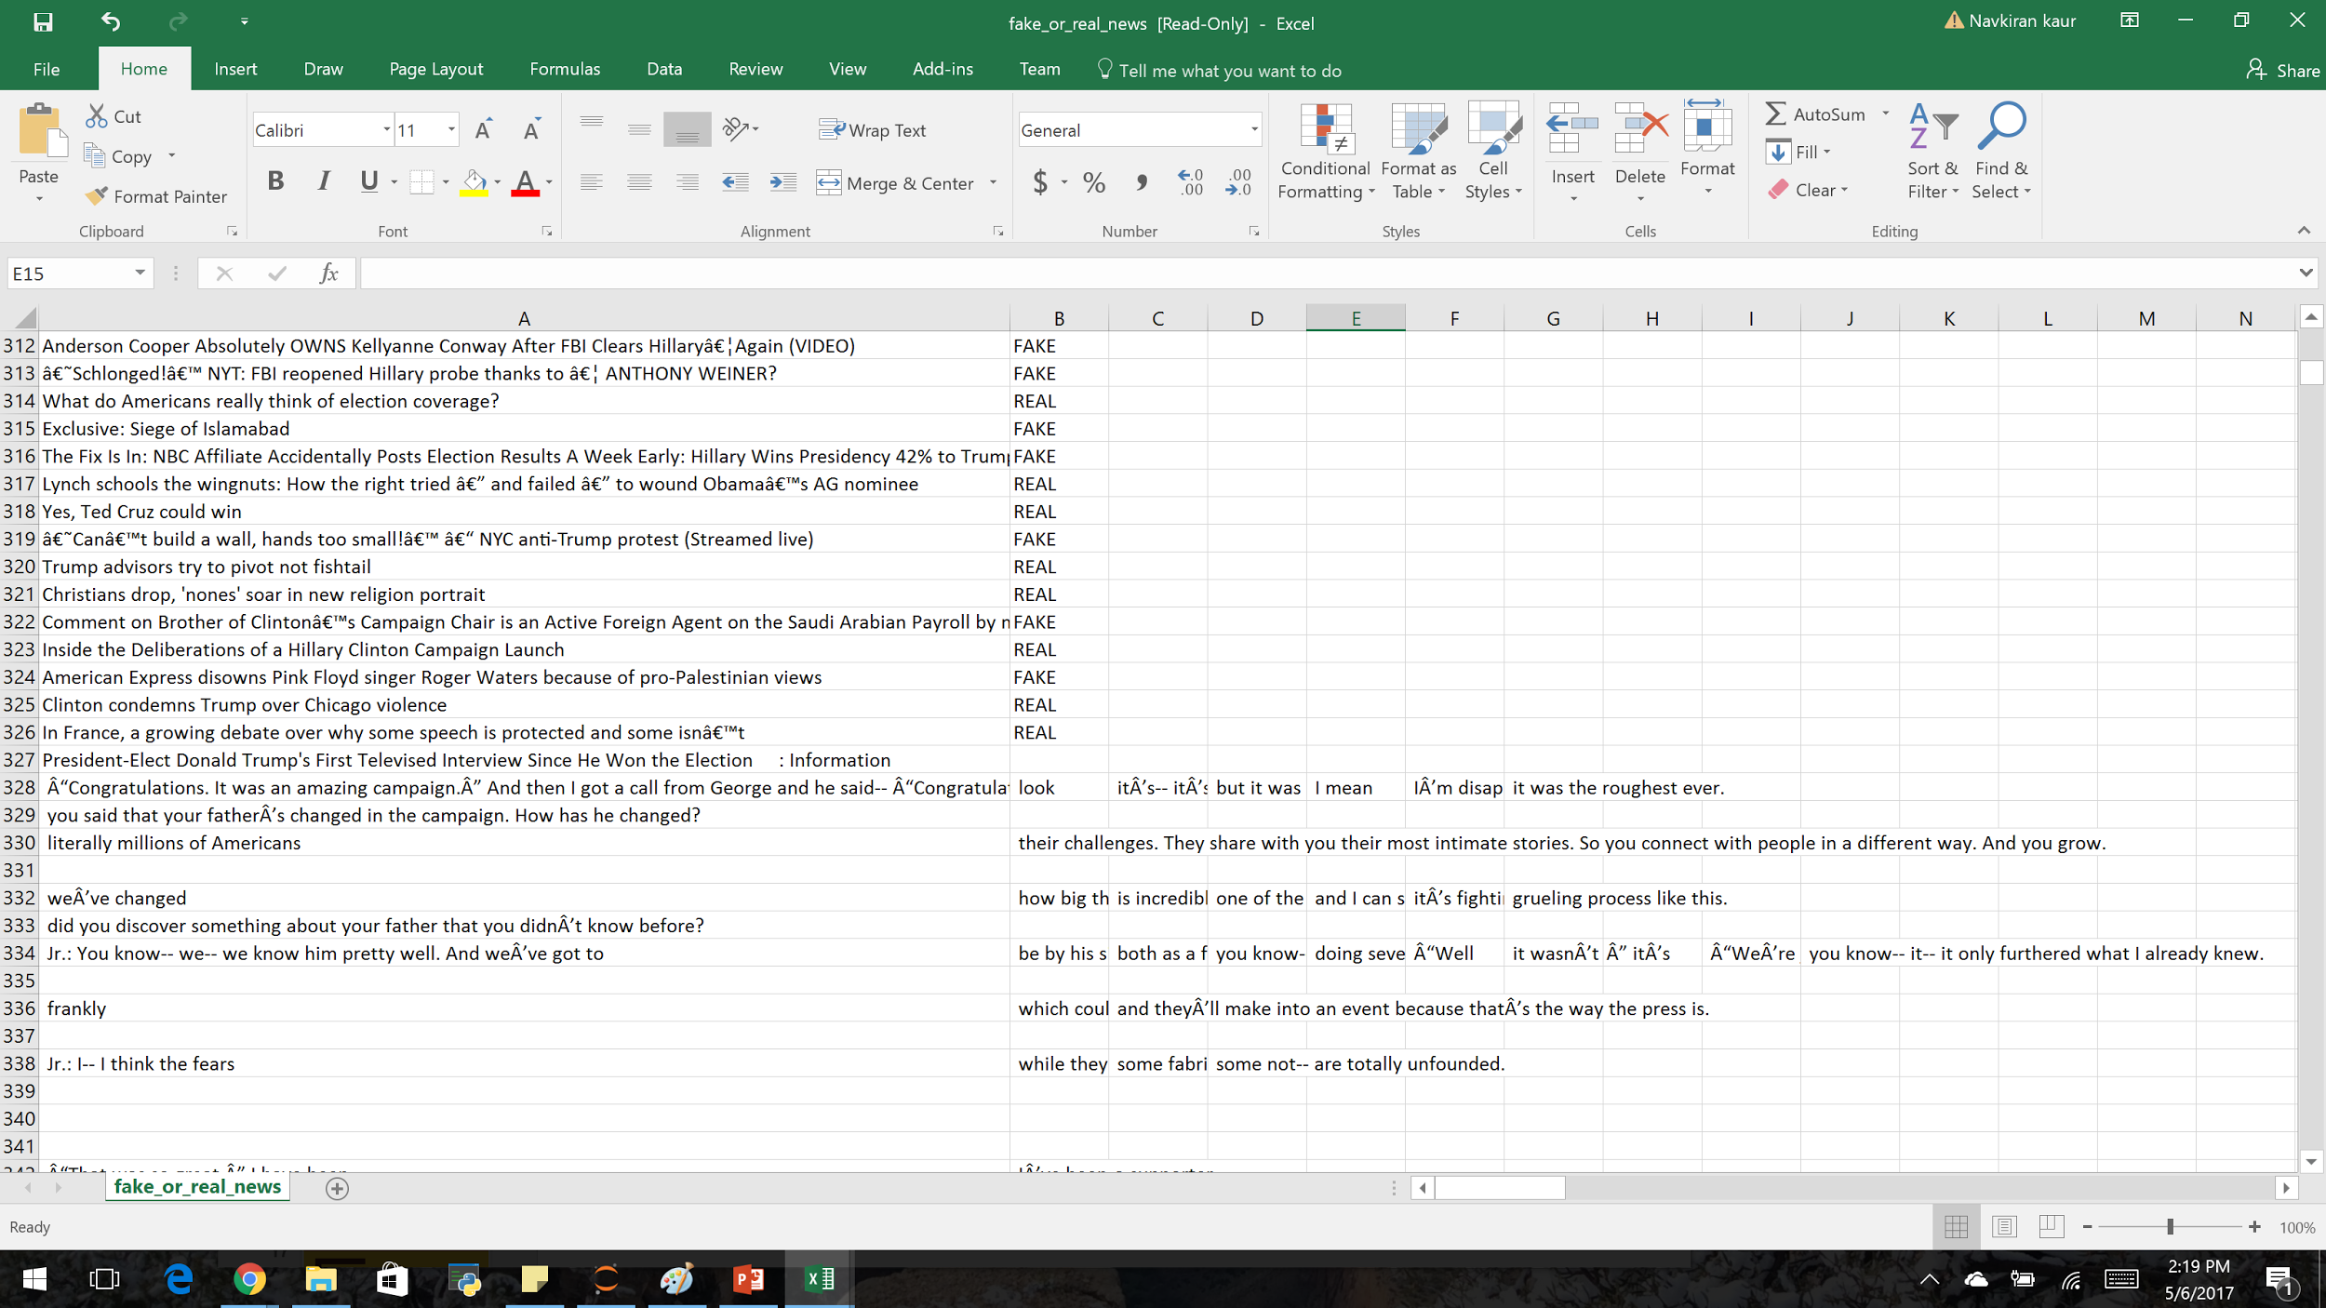
Raw Data

Slide 17
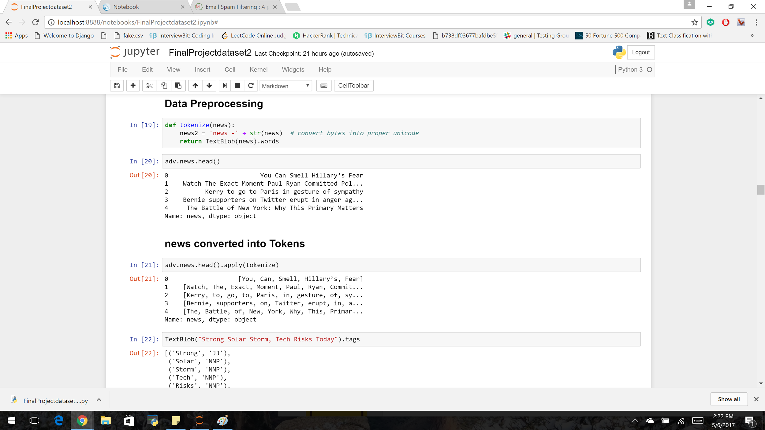
Data preprocessing and tokenization

Slide 18
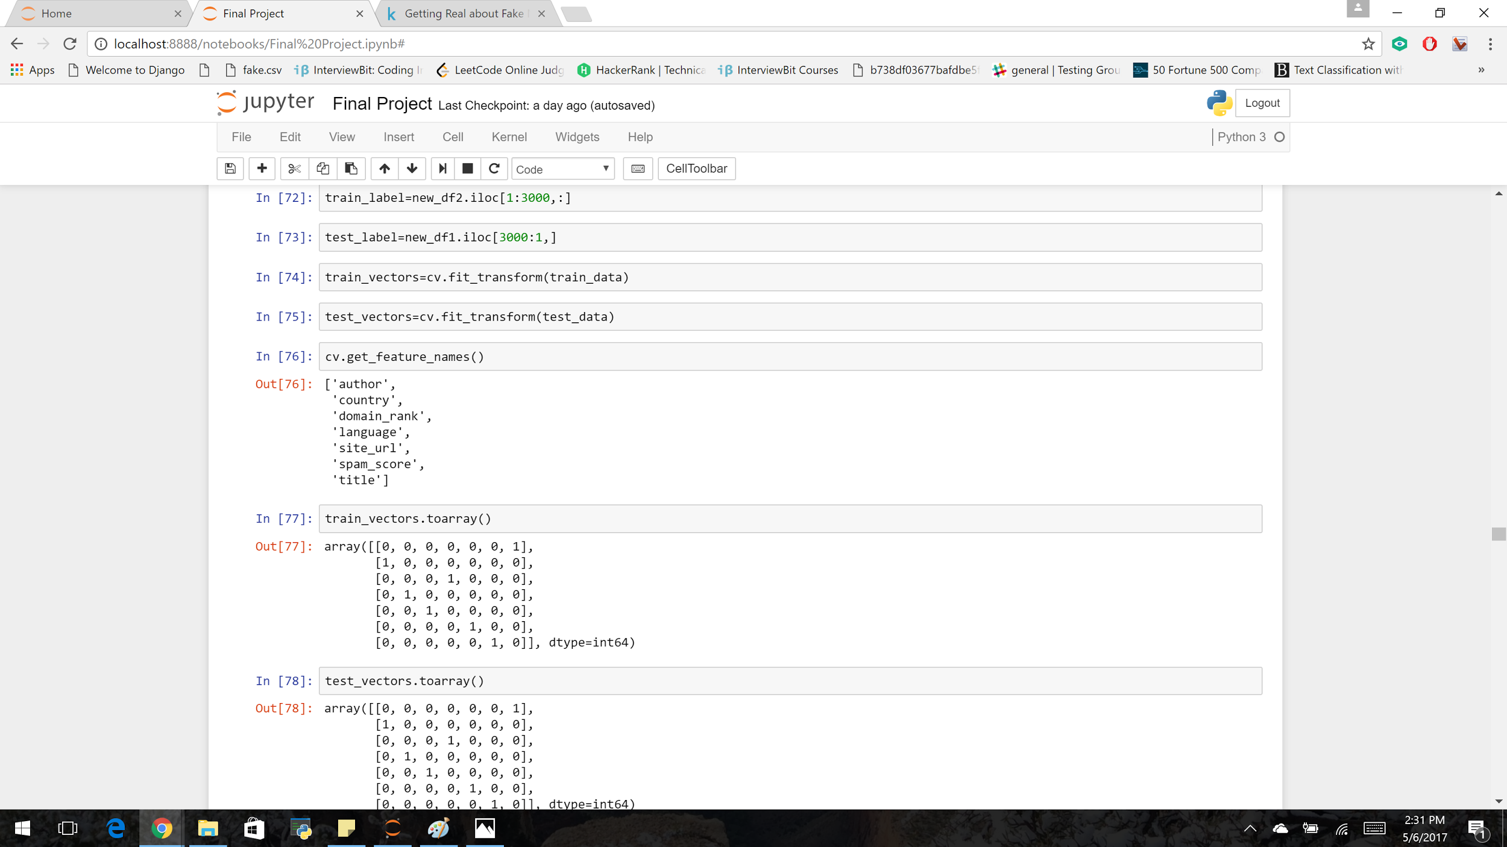
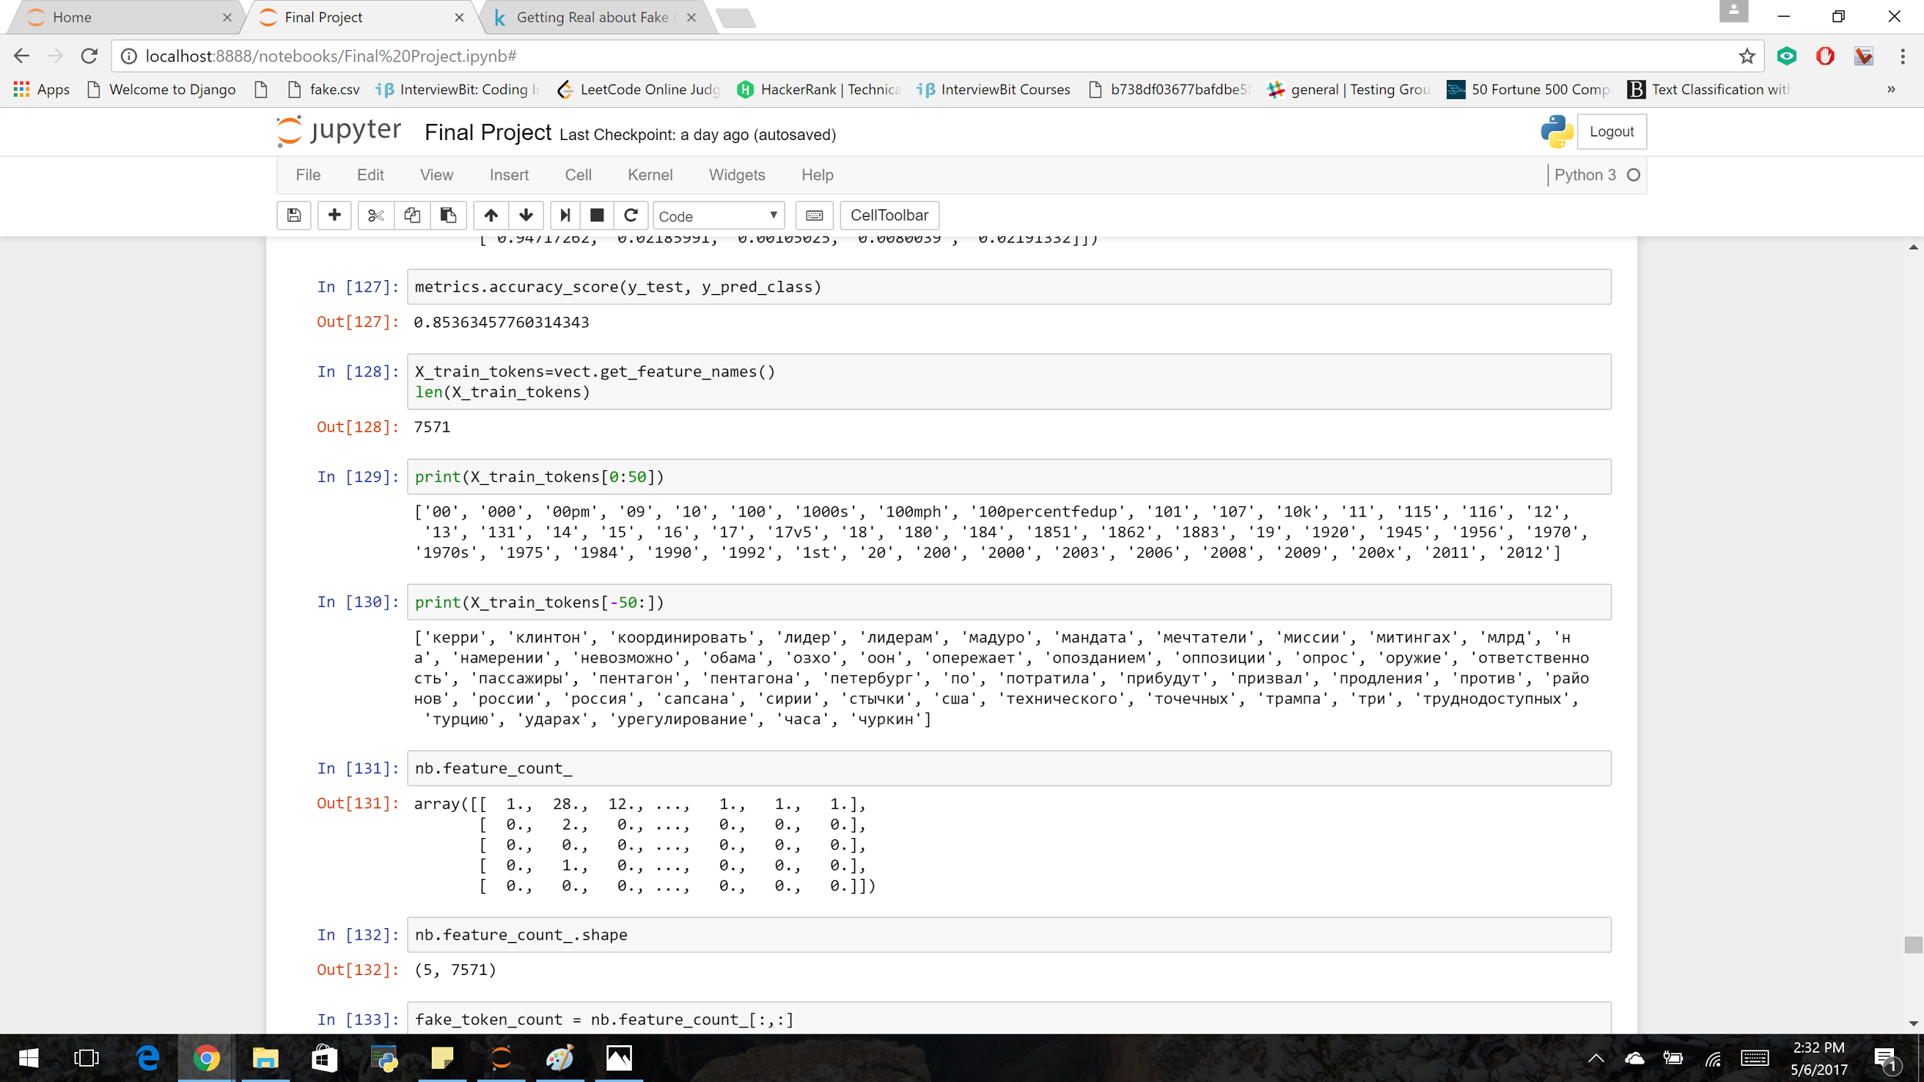
Feature Extraction

Slide 19
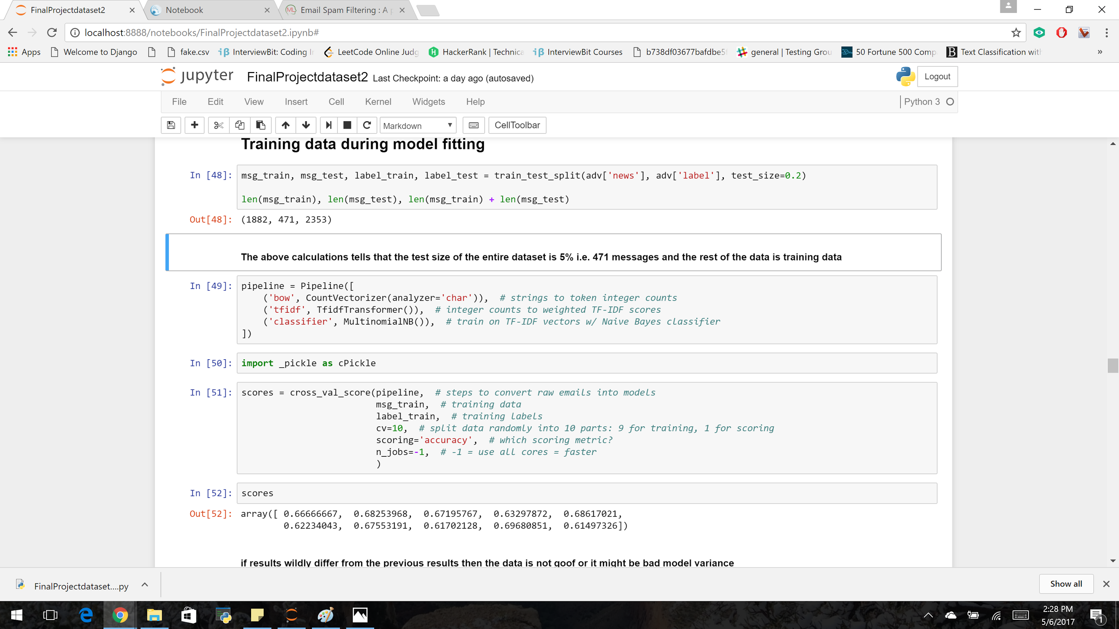
Training the Data
Training the Data

Slide 20
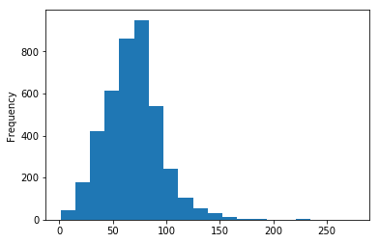
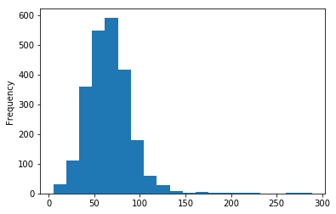
Demonstration- Plot of Length of news
Dataset 1
Dataset 2

Slide 21
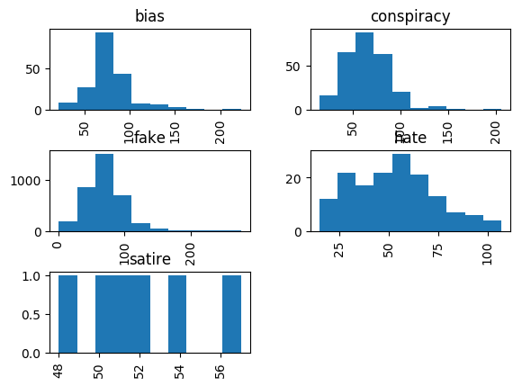
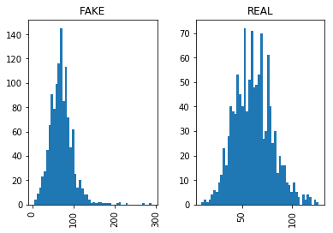
Length of labels
Dataset 1
Dataset 2

Slide 22
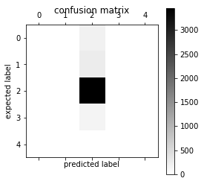
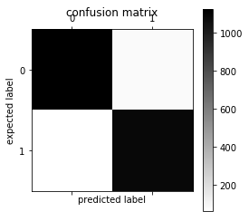
Confusion Matrix of prediction and expected label
Dataset 1
Dataset 2

Slide 23
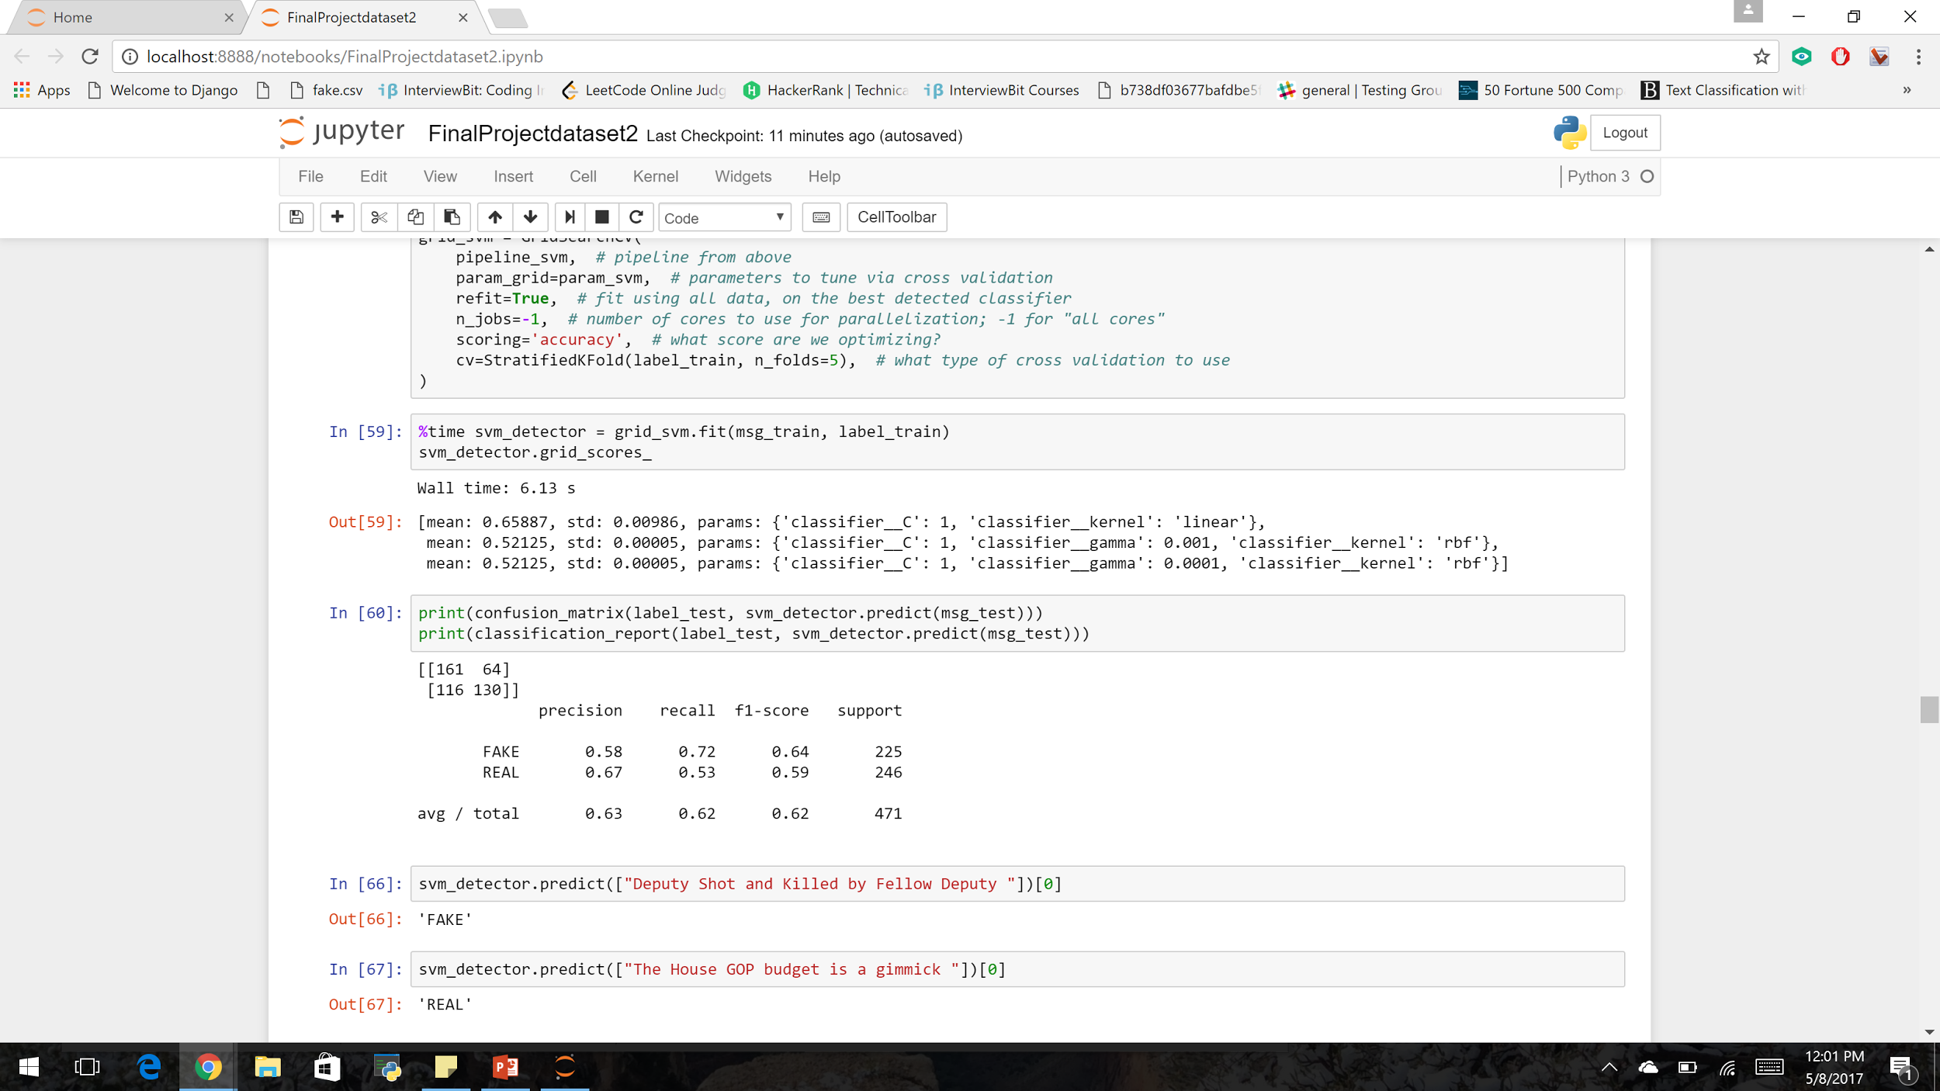
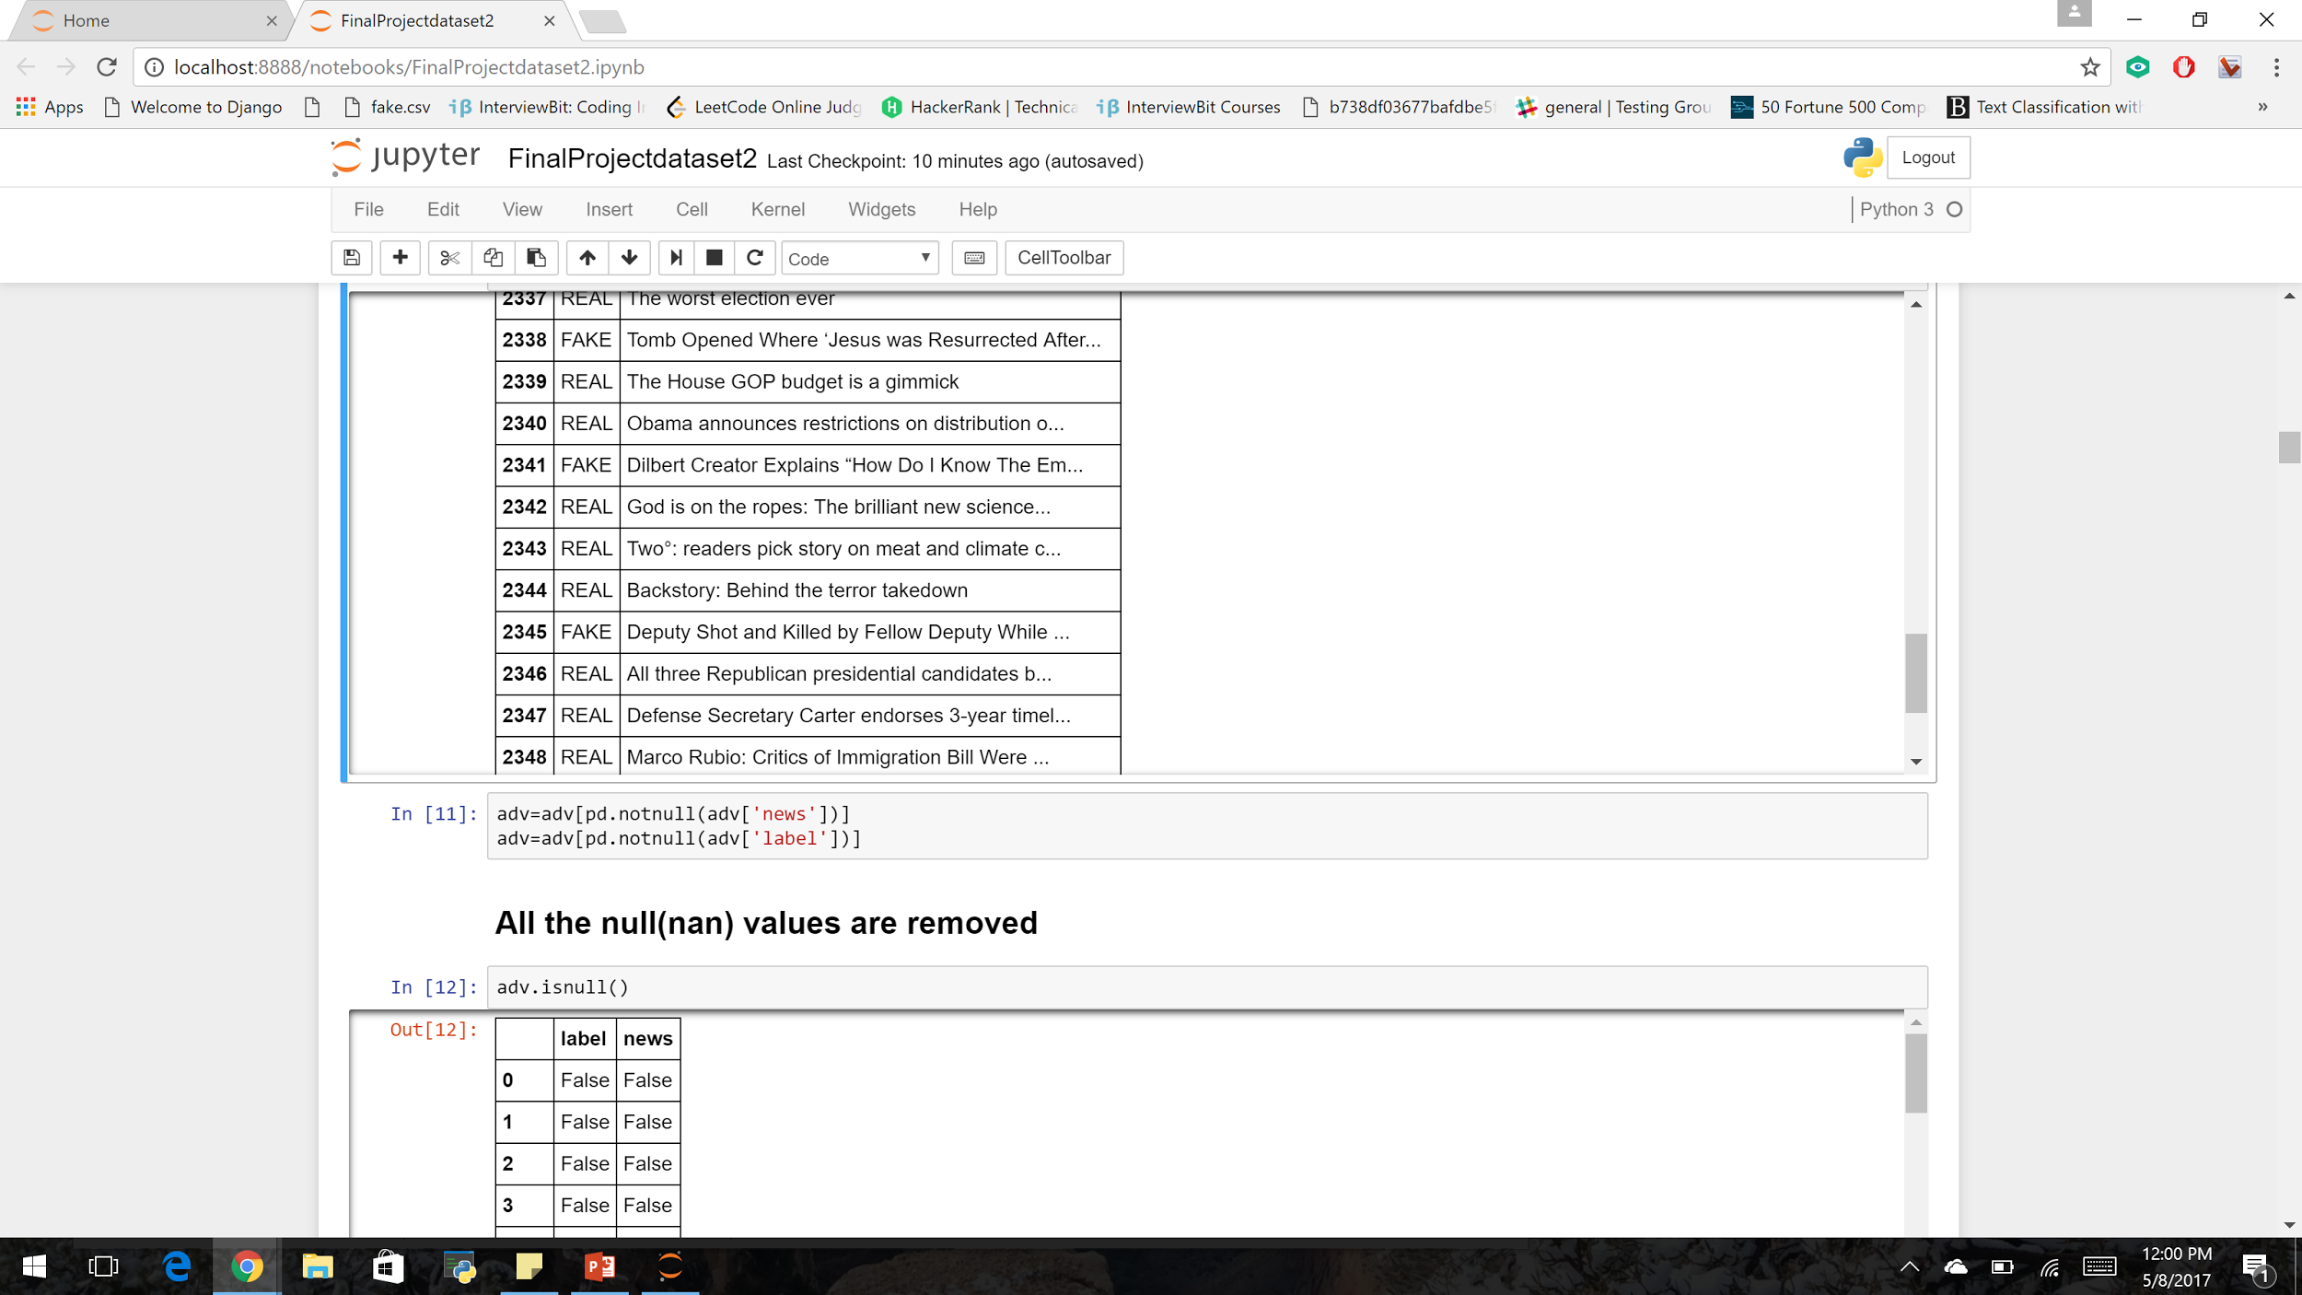
Test- Predicting whether the news is real or fake

Slide 24
Prediction Score
DataSet | Naive Bayes directly on training data just to test | Naive Bayes On training and testing data | SVM On training and testing data | KNN On training and testing data | Logistic Regression On training and testing data
Dataset 1 | 85 | 87.97 | 86 | 85 | 85.33
Dataset 2 | 94 | 80.14 | 63 | 59.77 | 80.64

Slide 25
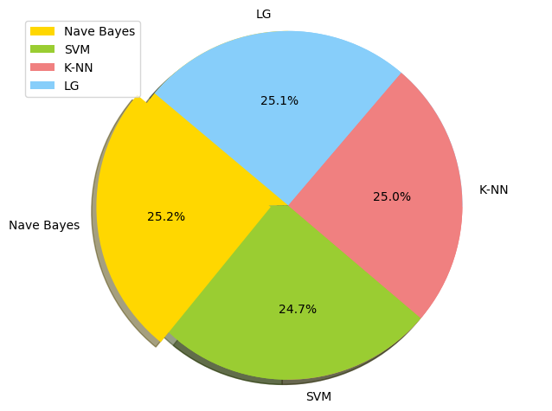
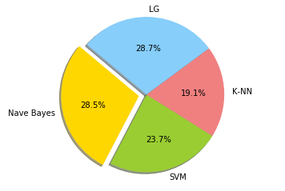

Slide 26
Spam detector time
DataSet | Naive Bayes | SVM | KNN | Logistic Regression
Dataset 1 | 4 ms | 6.88 s | 5.5 ms | 65.2 ms
Dataset 2 | 8.65 ms | 6.13 s | 3.01 ms | 43 ms

Slide 27
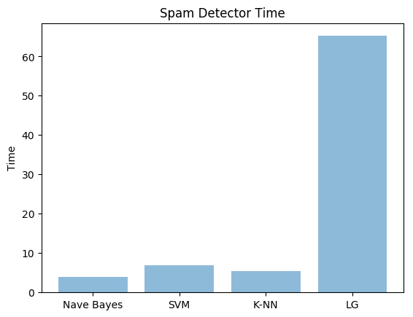
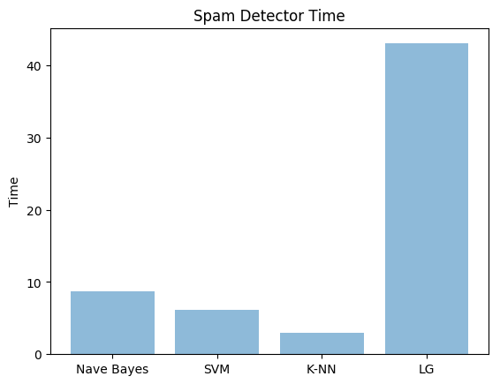

Slide 28
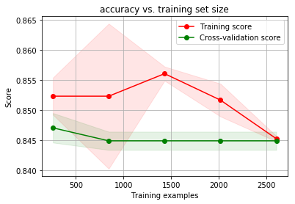
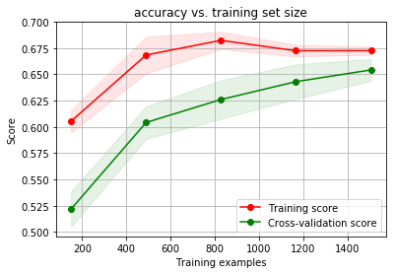
Accuracy in Training and Test Set
Dataset 1
Dataset 2

Slide 29
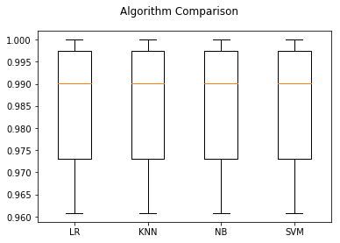
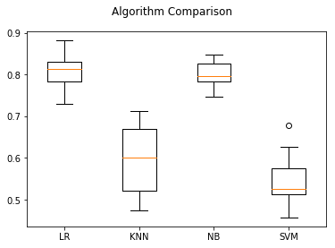
Algorithm Comparisons
Dataset 1
Dataset 2

Slide 30
Algorithm | Results Interpretable? | Predictive accuracy | PROBLEM TYPE | PREDICTIVE SPEED | ACCURACY | TRANING TIIME
NAVIE BAYES | yes | Higher | Classification | Fast | Good | Excellent
SVM | Yes | Medium | Classification/regression | Medium | Medium | Medium
LOGISTIC REGRESSION | Somewhat | Higher | Classification/regression | Slower | Moderate | Excellent
KNN | No | Lower | classification | fast | Lower | Good

Slide 31
Results
Algorithm’s accuracy depends on the type and size of your dataset. More the data, more chances of getting correct accuracy.
Machine learning depends on the variations and relations
Understanding what is predictable is as important as trying to predict it.
While making algorithm choice , speed should be a consideration factor.

Slide 32
Challenges
What kind of dataset to choose?
Which algorithm will be better of this kind of dataset.
Applying machine learning algorithms on text based dataset.
Feature updatations and degradations in SciKit learn versions.
Figuring which dataset to train and set.

Slide 33
References
http://scikit-learn.org/stable/supervised_learning.html#supervised-learning
https://en.wikipedia.org/wiki/Machine_learning
http://scikit-learn.org/stable/auto_examples/model_selection/plot_confusion_matrix.html
http://www.kdnuggets.com/2016/08/10-algorithms-machine-learning-engineers.html
http://scikit-learn.org/stable/modules/preprocessing.html
http://scikit-learn.org/stable/tutorial/basic/tutorial.html
http://scikit-learn.org/stable/user_guide.html
http://scikit-learn.org/stable/auto_examples/index.html
Shrawan Kumar Trivedi. A Study of machine learning classifiers for spam detection
Francisco Villegas Alejandre. Feature selection to detect botnets using machine learning algorithms
Abbasi, A. and Chen, H. "A Comparison of Tools for Detecting Fake Websites," IEEE Computer

